Slide 1
Customer Personality Analysis
P392
Group -5
Baira Mahendhar
Naga Sai Hari Deepika Rampalli
Samanvai govikar
Sushrut Laxman Nikalje
Rohini Mahajan
Yeshwanth Chalamarla

Slide 2
Introduction
Target - Need to perform clustering to summarize customer segments.
-Customer segmentation is a powerful tool for businesses, enabling them to deliver personalized experiences, optimize marketing efforts, and make strategic decisions. It helps businesses focus resources, improve customer satisfaction, and ultimately drive profitability. By understanding and serving distinct customer segments, businesses can achieve greater efficiency and effectiveness in their operations and marketing strategies.

Slide 3
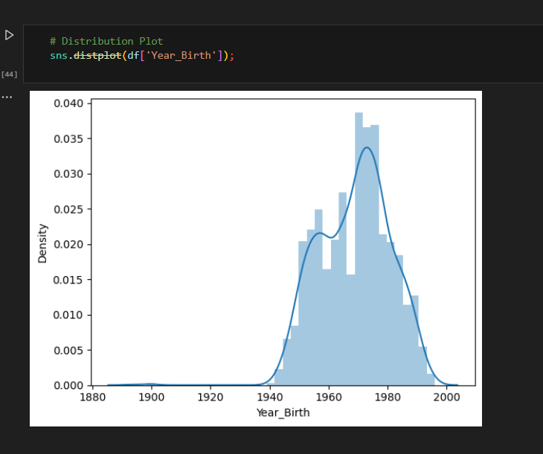
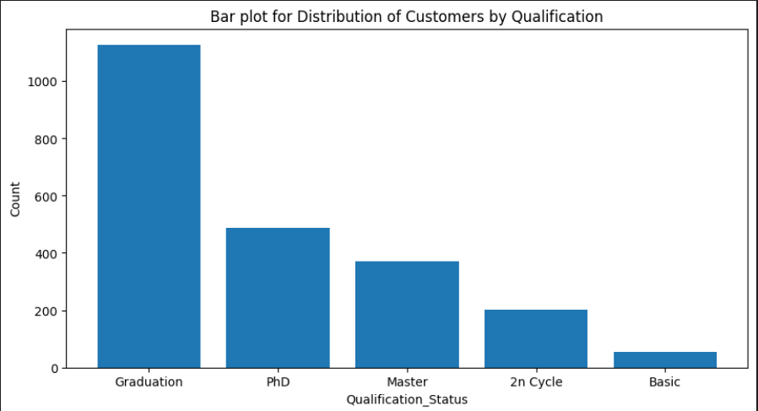
Exploratory data analysis
Univariate analysis
It was found that there are some null values in the “Income” variable/column.
Those null values are replaced with the median value.
Most of the customers were born between 1950 and 1990.
Most of the customers were from Graduation, Phd and masters educational background.

Slide 4
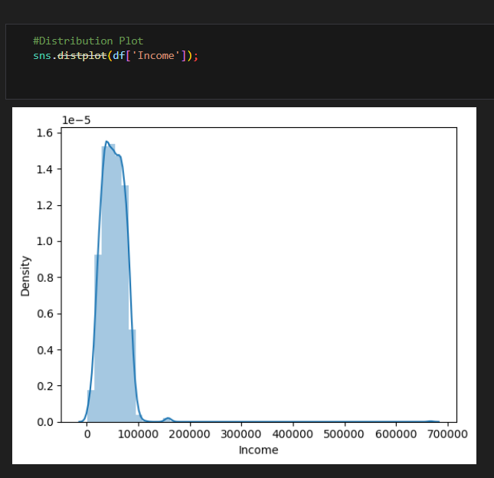
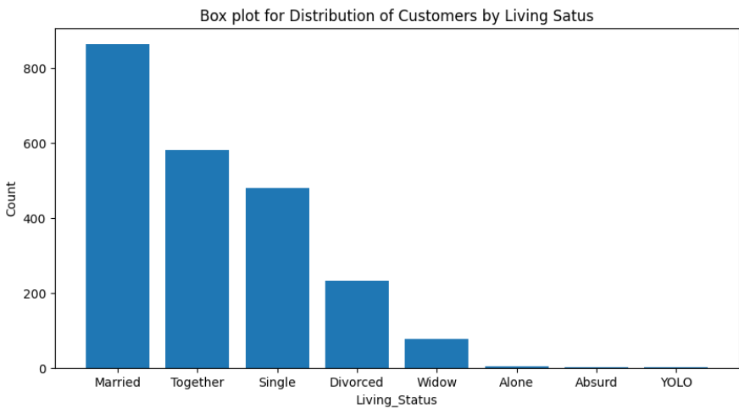
Most of the customers were earning an income below 1 Lakh.
Most of the customers were married.

Slide 5
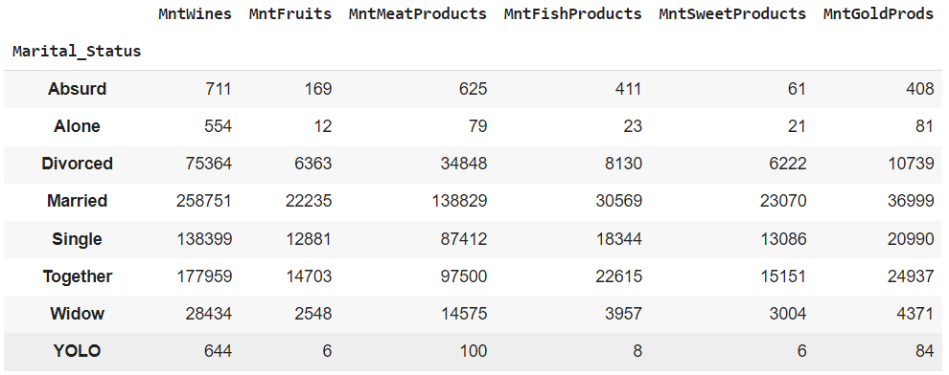
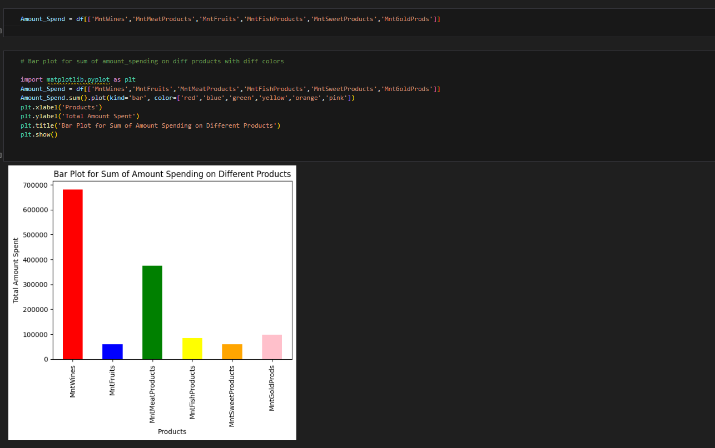
Bivariate ,Grouping and aggregation analysis
Married people were more interested in purchasing all products, followed by together people.
Most of the customers spend their money in wines purchases.

Slide 6
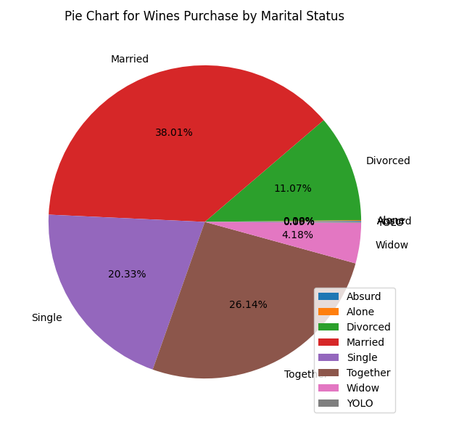
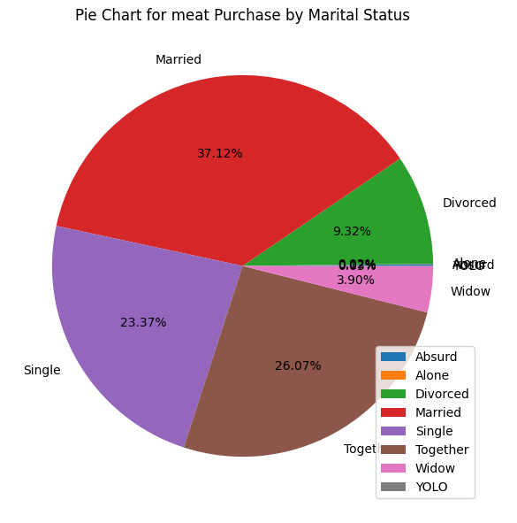
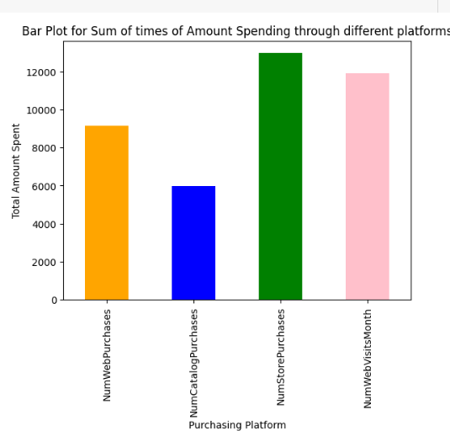
Married people were more interested in purchasing wine and meat products.
Most of the customers were interested in purchasing items through store only, followed by web purchases.

Slide 7
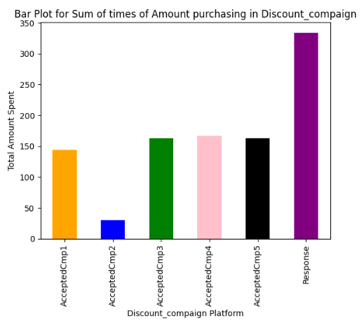
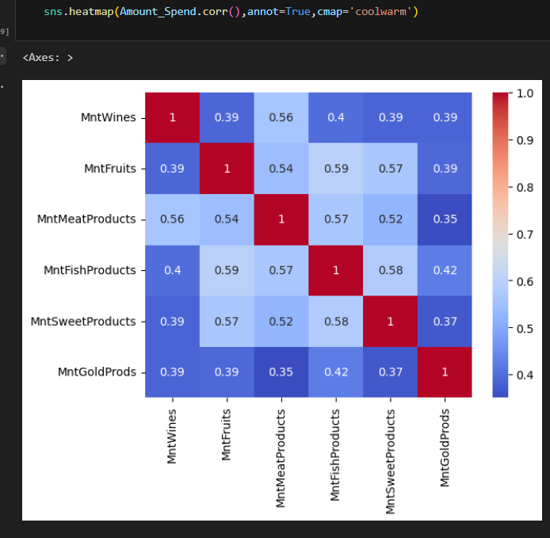
Out of all the campaigns , most of the people accepted the last campaign(response).
There exists strong correlation among the amount spent on wines, fruits, meat, fish and sweet products.

Slide 8
Feature Engineering
Few columns which are not required for the analysis are dropped.
The continuous and categorical variables were separated.
Label encoding was performed on categorical variables.
Standardization was applied on continuous variables using Standardscaler method.
PCA was applied on standardized continuous variables.

Slide 9
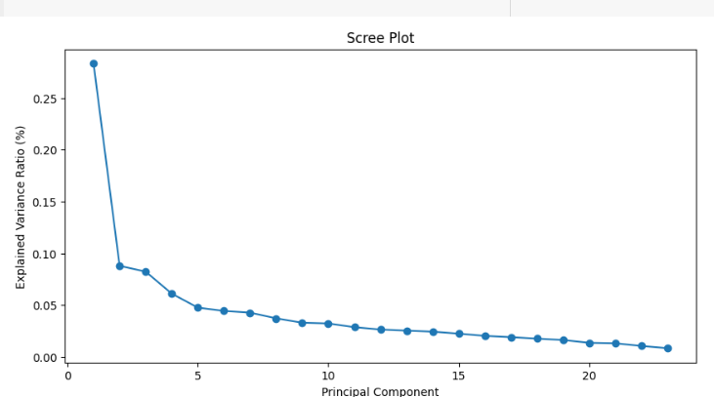
Scree Plot was plotted for PCA components and their explained variance ratios.
The number of PCA components selected were 2.
As the plot levels off after two components, the optimal number of pca components were 2.
After selecting PCA components, concatenated with encoded categorical variables for further analysis.

Slide 10
Model building & evaluation
Clustering
The task of grouping data points based on their similarity with each other is called Clustering or Cluster Analysis.
This method is defined under the branch of unsupervised learning, which aims at gaining insights from unlabelled data points.
There are many types of clustering such as K-means clustering,Agglomerative clustering,DBSCAN,Spectral clustering , etc.
In this project, K-means and agglomerative clustering were used to compare the results.

Slide 11
K-means clustering
K means clustering, assigns data points to one of the K clusters depending on their distance from the center of the clusters.
It starts by randomly assigning the clusters centroid in the space. Then each data point assign to one of the cluster based on its distance from centroid of the cluster.
After assigning each point to one of the cluster, new cluster centroids are assigned.
This process runs iteratively until it finds good cluster.

Slide 12
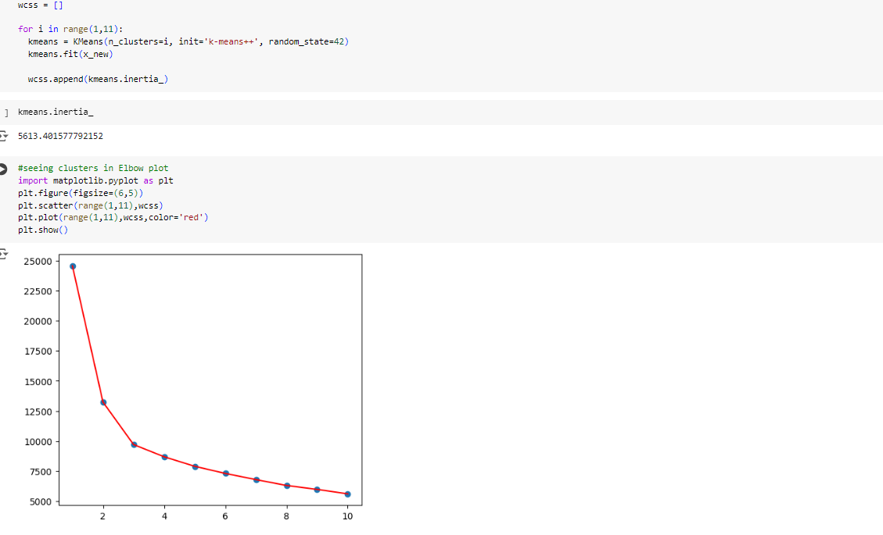
For finding the number of clusters, wcss (within cluster sum of squares) value is used.
Elbow plot was plotted for number of clusters and wcss value.
From the plot, it was observed that there was a rapid change in the curve from 0-2 .
After the 3rd point , there was less variation.
Therefore , the optimal number of clusters selected were 3 .

Slide 13
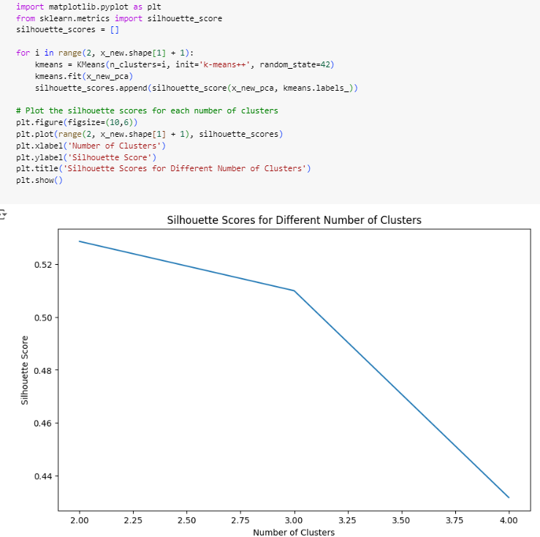
Similarly, using silhouette scores also the number of clusters were determined.
In this , the silhouette scores drops significantly after three clusters.
The optimal number of clusters were 3.

Slide 14
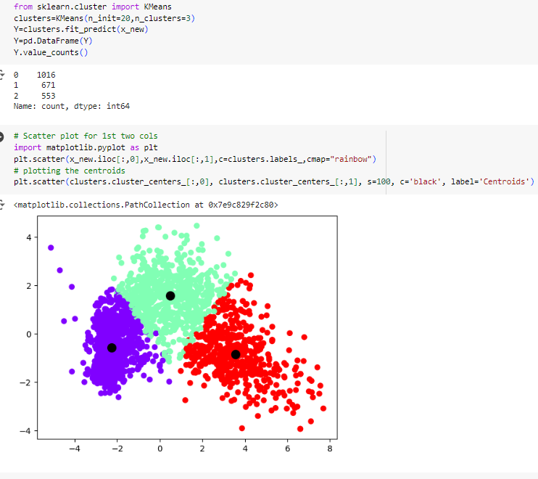
Now , k-means clustering was performed with 3 clusters.
The scatter plot was plotted .

Slide 15
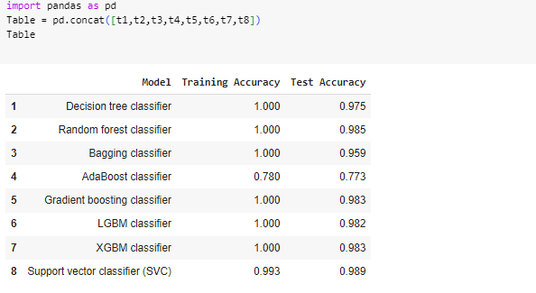
Various machine learning models were applied .
The training and test accuracies were calculated.
Out of all models, Random forest classifier gives better results than others.

Slide 16
Agglomerative clustering
Agglomerative clustering is a hierarchical algorithm that uses a bottom-up approach.
Each data point is initially considered a “cluster.”
The algorithm proceeds by successively merging clusters using a selected linkage criterion.
Criterion using ward, complete, average, and single linkage minimizes the sum of squared distances within all clusters, the maximum distance between observations of pairs of clusters, the average of the distances between all observations of pairs of clusters, and the distance between the closest observations of pairs of clusters, respectively.

Slide 17
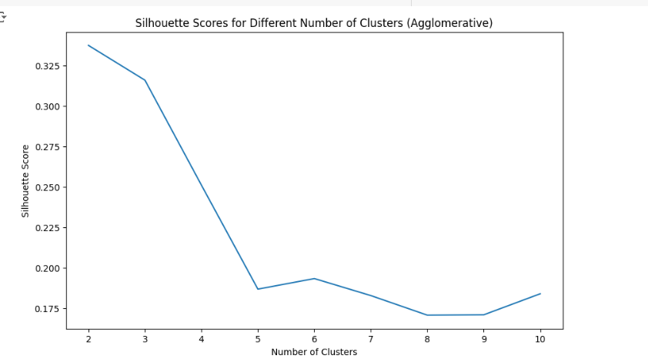
Using silhouette scores, the number of clusters determined were 3.

Slide 18
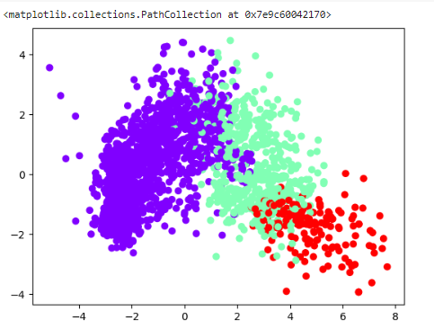
Agglomerative clustering was performed on 3 clusters.
The scatter plot was plotted.

Slide 19
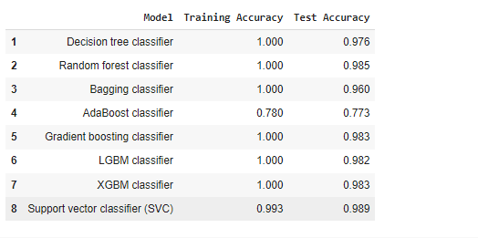
Random forest classifier gives best results.
Out of the two clustering methods used, k-means clustering gives best results than agglomerative clustering. Therefore , K-means clustering was selected and Random forest classifier model was evaluated.

Slide 20
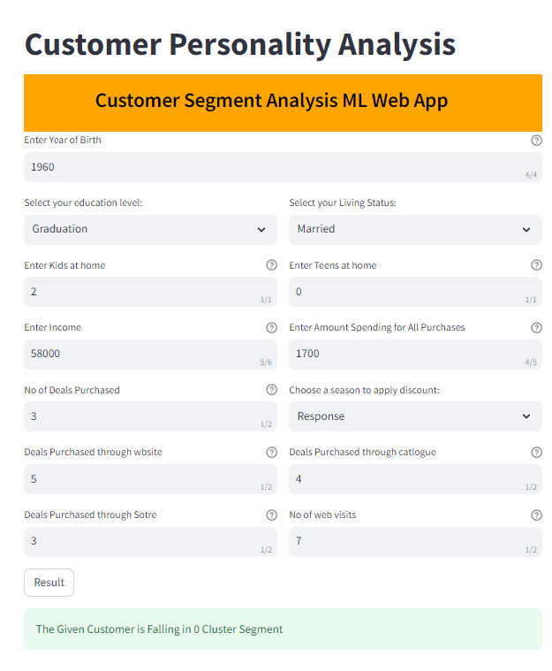
Deployment
The Random forest classifier model was selected as final model for deployment.
The algorithm gives 98.5% accuracy for test data.
Deployment was done using Stream-lit platform.

Slide 21
Challenges faced
The data contains missing values.
The dataset contains some unnecessary columns/variables.
There were so many variables such that it became difficult for analysis.
It was difficult to find best accuracy for the data.
Faced challenges while deployment , as there were some errors in the code.

Slide 22
How we overcame challenges faced
For the missing values, replaced them with the median value of that particular variable/column.
All the unnecessary columns/variables were dropped.
Used PCA method for selecting the best features for analysis.
Performed many ML models for comparison of accuracies and the best was selected.
Fixed the errors in the code and used Stream-lit platform for deployment.

Slide 23
THANK YOU

